Slide 1
Adult Income
Adam DeJans, Nathalie Tate

Slide 2
Problem Description
The prediction task is to determine whether a person makes over $50K a year.
This data was extracted from the 1994 Census bureau database

Slide 3
Variable Descriptions
Continuous
Categorical
Age
Capital-gain
Capital-loss
Fnlwgt
Hours-per-week
Education-num
Race
Sex
Workclass
Native-country
Relationship
Education
Marital-status
Occupation

Slide 4
More on Categorical Data
workclass: Private, Self-emp-not-inc, Self-emp-inc, Federal-gov, Local-gov, State-gov, Without-pay, Never-worked.
education: Bachelors, Some-college, 11th, HS-grad, Prof-school, Assoc-acdm, Assoc-voc, 9th, 7th-8th, 12th, Masters, 1st-4th, 10th, Doctorate, 5th-6th, Preschool.
marital-status: Married-civ-spouse, Divorced, Never-married, Separated, Widowed, Married-spouse-absent, Married-AF-spouse.
occupation: Tech-support, Craft-repair, Other-service, Sales, Exec-managerial, Prof-specialty, Handlers-cleaners, Machine-op-inspct, Adm-clerical, Farming-fishing, Transport-moving, Priv-house-serv, Protective-serv, Armed-Forces.

Slide 5
More on Categorical Data
relationship: Wife, Own-child, Husband, Not-in-family, Other-relative, Unmarried.
race: White, Asian-Pac-Islander, Amer-Indian-Eskimo, Other, Black.
sex: Female, Male.
native-country: United-States, Cambodia, England, Puerto-Rico, Canada, Germany, Outlying-US(Guam-USVI-etc), India, Japan, Greece, South, China, Cuba, Iran, Honduras, Philippines, Italy, Poland, Jamaica, Vietnam, Mexico, Portugal, Ireland, France, Dominican-Republic, Laos, Ecuador, Taiwan, Haiti, Columbia, Hungary, Guatemala, Nicaragua, Scotland, Thailand, Yugoslavia, El-Salvador, Trinadad&Tobago, Peru, Hong, Holand-Netherlands.

Slide 6
Class Distribution
The class distribution is strongly biased towards a person making less than or equal to 50K (75.1%).
class <=50K 22653 >50K 7508

Slide 7
Background Knowledge
It has been found through many sociological texts that when it comes to wages there is a race and gender gap.
It has been studied that given similar occupations:
Asians make the highest income, and
Men make more than women
With Asian-men being the highest earners.

Slide 8
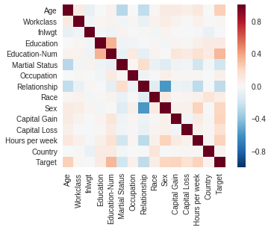
Data Exploration (pre-cleaning)

Slide 9
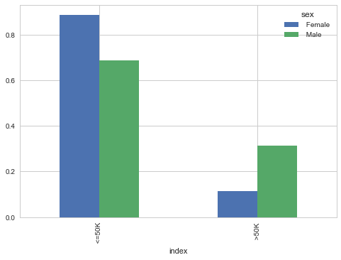
Data Exploration (pre-cleaning)

Slide 10
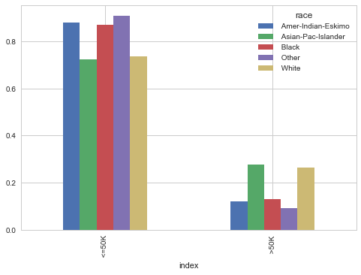
Data Exploration (pre-cleaning)

Slide 11
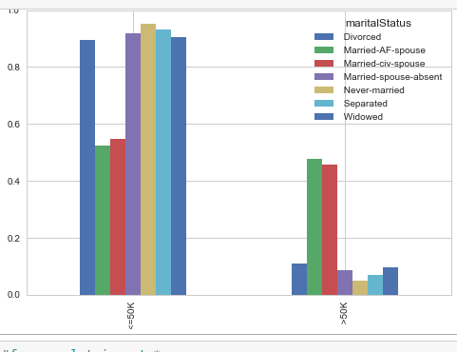
Data Exploration (pre-cleaning)

Slide 12
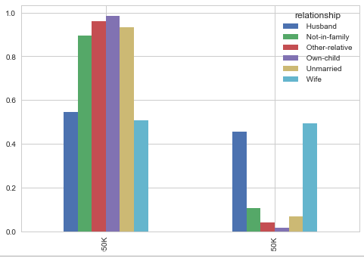
Data Exploration (pre-cleaning)

Slide 13
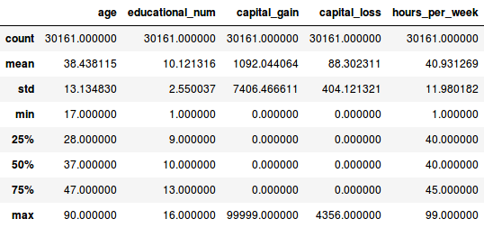
Descriptive Statistics of Continuous Variables

Slide 14
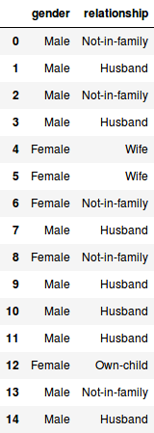
Data Exploration (pre-cleaning)
Obvious high correlation with male-husband & female-wife
There’s not much that can be done to transform this

Slide 15
Cleaning The Data
32562 rows of data
2399 rows were removed due to missing values
1 row was removed because it had a unique value for “native-country”
People with similar demographic characteristics will have similar weights. Unfortunately, this only applies within states and not to the general population, so we dropped the “fnlwgt” variable

Slide 16
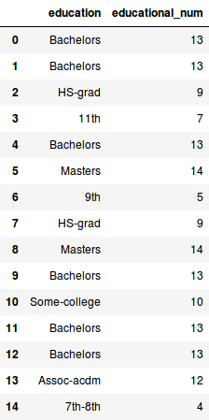
Education
The “education” variable was dropped because it had a one-to-one correspondence to the “education-num” variable

Slide 17
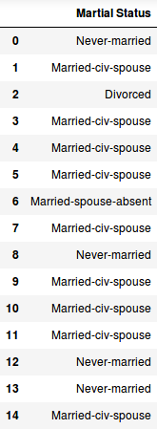
Marital-status
“Marital-status” had its various values
Married-civ-spouse
Divorced, Never-married
Separated,
Widowed,
Married-spouse-absent
Married-AF-spouse
Mapped to two values:
Married
Not married

Slide 18
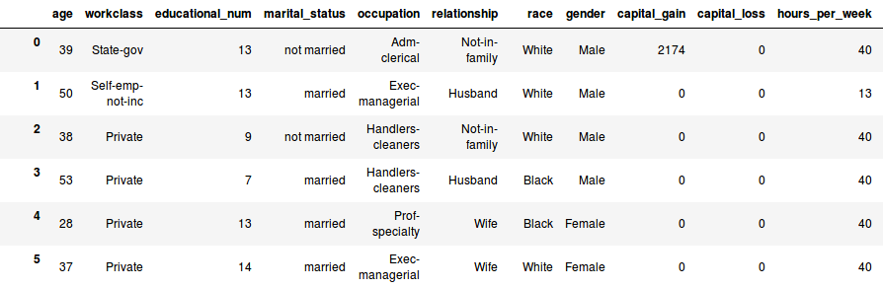
Marital-status Mapped to Binary Values

Slide 19
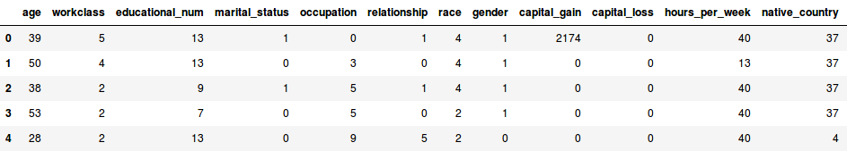
Categorical Data
Categorical data was mapped to continuous values using scikit-learn

Slide 20
Feature Selection
If a binary variable:
scipy.stats.spearmanr(a, b=None, axis=0, nan_policy='propagate')[source]
Calculates a Spearman rank-order correlation coefficient and the p-value to test for non-correlation.
The Spearman correlation is a nonparametric measure of the monotonicity of the relationship between two datasets. Unlike the Pearson correlation, the Spearman correlation does not assume that both datasets are normally distributed. Like other correlation coefficients, this one varies between -1 and +1 with 0 implying no correlation. Correlations of -1 or +1 imply an exact monotonic relationship. Positive correlations imply that as x increases, so does y. Negative correlations imply that as x increases, y decreases.
The p-value roughly indicates the probability of an uncorrelated system producing datasets that have a Spearman correlation at least as extreme as the one computed from these datasets. The p-values are not entirely reliable but are probably reasonable for datasets larger than 500 or so.

Slide 21
Feature Selection
If a continuous variable:
scipy.stats.pointbiserialr(x, y)[source]
Calculates a point biserial correlation coefficient and the associated p-value.
The point biserial correlation is used to measure the relationship between a binary variable, x, and a continuous variable, y. Like other correlation coefficients, this one varies between -1 and +1 with 0 implying no correlation. Correlations of -1 or +1 imply a determinative relationship.
This function uses a shortcut formula but produces the same result as pearsonr.

Slide 22
Feature Selection
scipy.stats.pearsonr(x, y)[source]
Calculates a Pearson correlation coefficient and the p-value for testing non-correlation.
The Pearson correlation coefficient measures the linear relationship between two datasets. Strictly speaking, Pearson’s correlation requires that each dataset be normally distributed. Like other correlation coefficients, this one varies between -1 and +1 with 0 implying no correlation. Correlations of -1 or +1 imply an exact linear relationship. Positive correlations imply that as x increases, so does y. Negative correlations imply that as x increases, y decreases.
The p-value roughly indicates the probability of an uncorrelated system producing datasets that have a Pearson correlation at least as extreme as the one computed from these datasets. The p-values are not entirely reliable but are probably reasonable for datasets larger than 500 or so.
https://docs.scipy.org/doc/scipy-0.14.0/reference/generated/scipy.stats.pearsonr.html

Slide 23
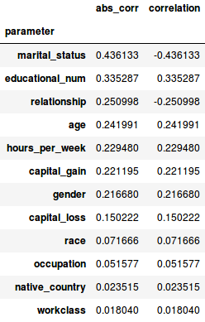
Feature Selection
A look at the correlation of variables in relation to the salary outcome.

Slide 24
Best Features
Marital Status
Educational Number
Relationship
Age
Hours per week
Capital Gain
Gender

Slide 25
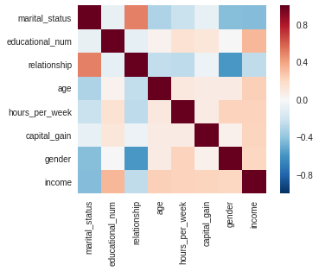
Heat Map of Best Features

Slide 26
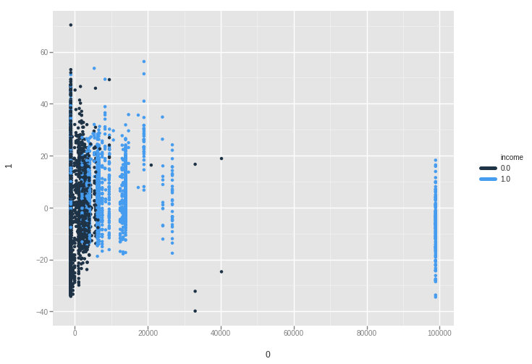
PCA

Slide 27
Cross Fold Validation 5-fold
Used Sci-kit learn package to complete a 5-fold cross validation with the adult data set

Slide 28
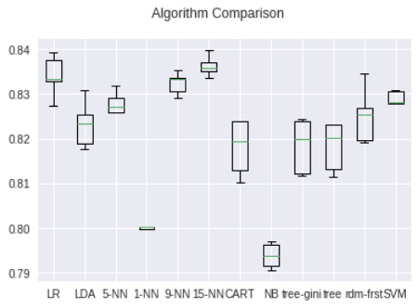
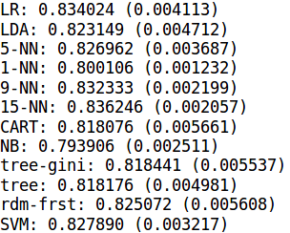
Algorithm Comparison
Mean and Standard Deviation

Slide 29
Running The Model on the Test Set
The supplied test set had 15,060 rows of data after being cleaned.
---
Rows with missing data were deleted
Marital-Status was transformed to “married”/”not married”
Categorical data was assigned a number (w/ scikit-learn)

Slide 30
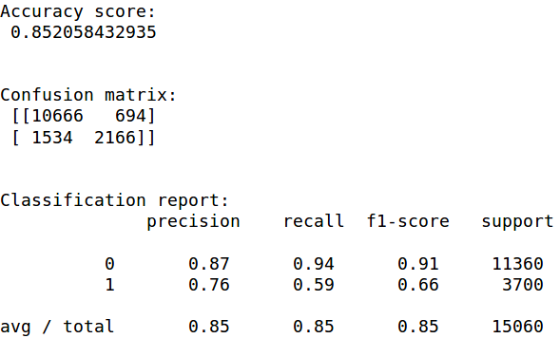
Scoring of 15 Nearest Neighbors Algorithm

Slide 31
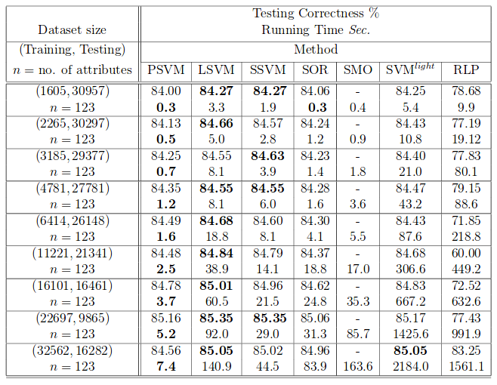
Comparison to Paper Results
http://pages.cs.wisc.edu/~gfung/Glenn_fung_Phd_thesis.pdf
David R. Musicant. DATA MINING VIA MATHEMATICAL PROGRAMMING AND MACHINE LEARNING. Doctor of Philosophy (Computer Sciences) UNIVERSITY.

Slide 32
Conclusions
Naive Bayes didn’t predict as well as the others; we can assumably attribute this to the necessary assumed independence that is required of the variables when using Naive Bayes
Nearest Neighbor and SVM seemed to be the most consistent
Perhaps the best way to become rich:
Be a married middle-aged man who works a lot of hours and invests his money.

